Slide 1

General Biology
Dr. sraa nsayef

Slide 2
Human Tissues
Lab ((9))

Slide 3
Tissue Types
1- Muscle
2- Epithelial
3- Connective
4- Nervous

Slide 4
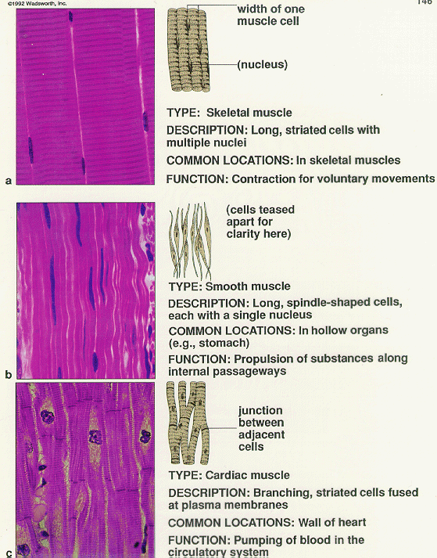
3 types of muscle tissue
1- Cardiac –heart

Slide 5
2- Skeletal – attached to bones

Slide 6
3- Smooth – internal organs and blood vessels

Slide 7
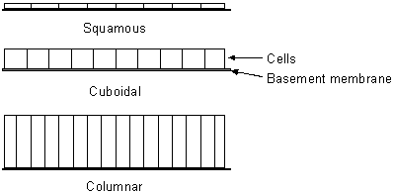
Epithelial Tissue
3 types of epithelial tissue
Squamous
Cuboidal
Columnar

Slide 8
Connective Tissue :-
6 Types
Loose connective tissue
Dense connective tissue
Adipose
Blood
Cartilage
Bone

